Slide 1


Butterfly Wings as an Optomechanical Array for Imaging
Hrvoje Skenderović
Institute of Physics, Bijenička cesta 46,HR-10000 Zagreb, Croatia
Digital Holography and Three-Dimensional Imaging, 1-4.8. 2022, Cambridge, UK

Slide 2
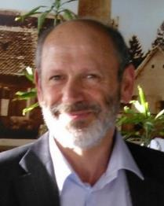


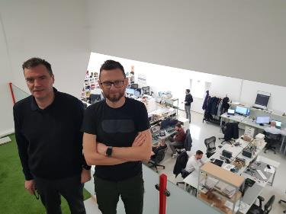



Contributions:
Institute of Physics, Zagreb: N. Demoli, A. Mardan, D. Abramović, M. Rakić
Orqa, Osijek: S. Kovačević
Institute of Physics, Beograd: D. Pantelić
Funding:
Project site:
www: holobio.ifs.hr
NATO SPS MYP G5618
No. DOK-2020-01-8574

Slide 3
Signal detection and imaging in invisible spectral regions is interesting in both military and civil applications. Therefore, there is a constant need for improving devices sensitive on UV, IR or more recently THz radiation. In a core of modern imaging devices is a focal plane array (FPA), i.e., an array of radiation detectors placed in the focal plane of an imaging system.
We want o design an imaging device with optical reading and with mechanical nano- and micro-structures as sensitive elements – pixels.

Slide 4



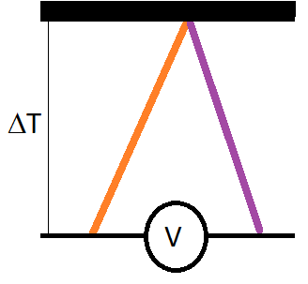

Infrared sensors
Photon-based sensors
Thermal-based sensors
Conduction band
Gap
Valence band
IR absorber
Thermo sensitive material
Photoconductive sensors
Photovoltaic sensors
Bolometers and Pyroelectric sensors
Thermocouples
Photomechanic sensors
[A. Rogalski, Opto-Electron. Rev. 2012, 20, 279, Copyright 2012, De Gruyter]

Slide 5
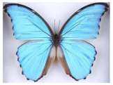
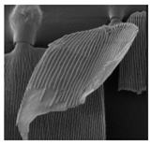
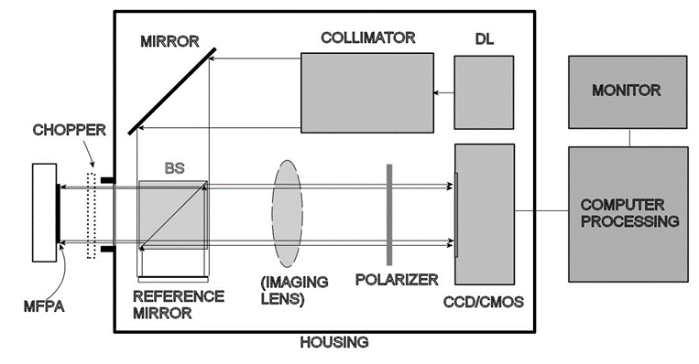
The aim of this project is to develop a proof-of-the-concept multispectral system, inspired by, evolutionary optimized, nano- and micro-structures of insect wings. Compared to existing systems, which are restricted to narrow spectral bands, the proposed system will cover ultraviolet (UV), visible and infrared (IR) radiation. Micron-sized particles with internal nanostructures, similar to butterfly wing scales, will be used as sensing elements. Radiation-induced perturbations will be amplified by the interaction with the surrounding gas and detected by sensitive holographic techniques.

Slide 6
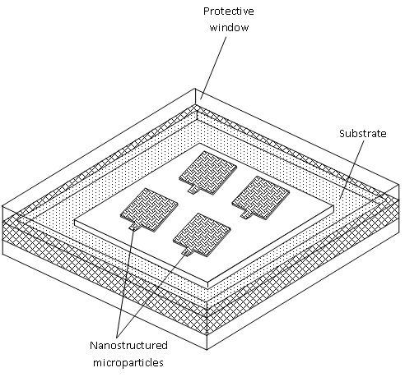
Thermomechanical sensors
Infrared (IR) technology is a crucial technology for various
safety, surveillance and vision enhancement applications
Visual readout beams
A schematic working principle of a micro thermomechanical IR sensor: The FPA exhibits deflection upon temperature rise due to absorbed IR radiation. This deflection changes reflection of the readout beam reflection.
Multipixel focal point array (MP FPA)

Slide 7

One example of optomechanical device:
Successive infrared images of a filament captured at 200 fps
during its (a) lighting and (b) fusion cycle.

Slide 8
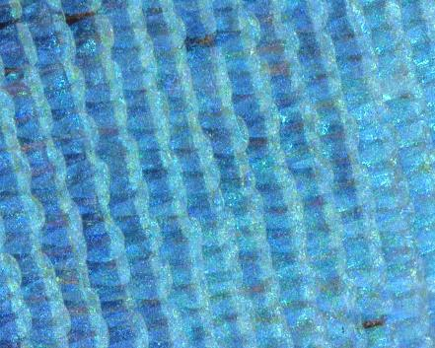
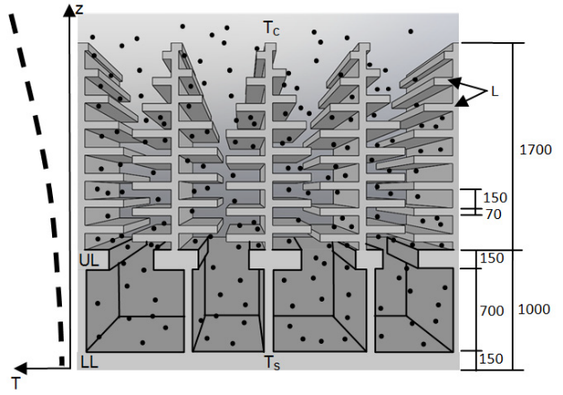
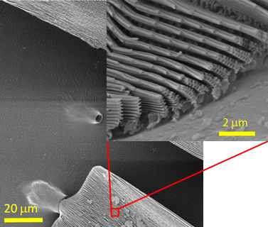
Butterfly wings as a thermo imaging sensor
Radiation-induced heating produces an additional, thermophoretic force that deforms the wing-scales. Deformations can be detected by sensitive holographic techniques
Microscopic image of a butterfly wing
Scheme of the cross-section of a Morpho butterfly scale.
SEM image showing the cantilever-like structure of the Morpho menelaus wingscale and ultrastructure of its surface, with number of lamellae
D. Grujić, D. Vasiljević, D. Pantelić, Lj. Tomić, B. Jelenković, "Infrared camera on a butterfly wing" Opt. Express 26 1443 - 14158

Slide 9
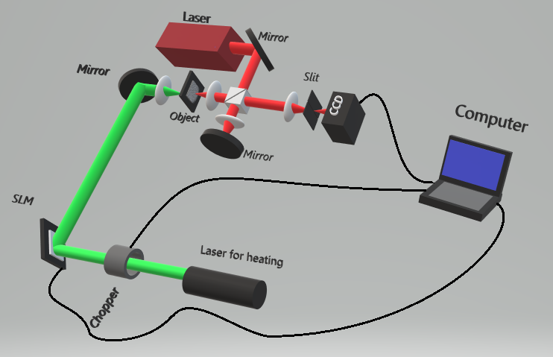
Testing setup with digital holographic microscope
We have configured a Twyman – Green interferometer for digital holographic microscope (DHM) with He-Ne laser as a laser source. In this application of DHM essential is to get fringe pattern corresponding to contours of constant elevation with respect to a reference plane. Such contours can be used to determine the shape of a three-dimensional object. Interferograms usually demands recording of two holograms, one of surface without deformation (background), the other of the deformed surface.

Slide 10
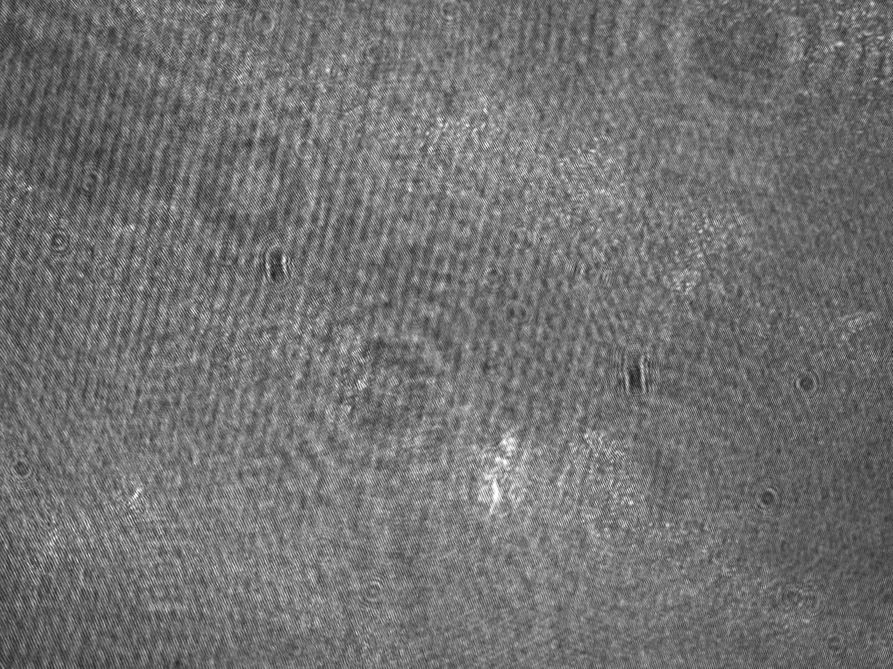
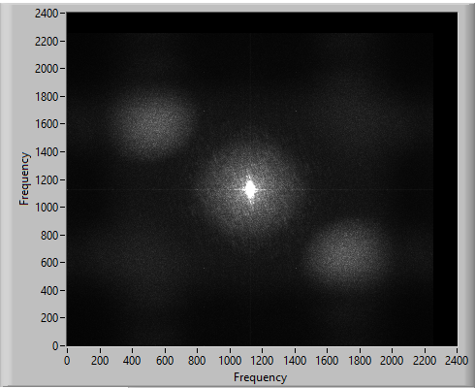
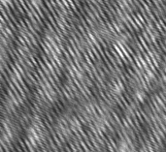
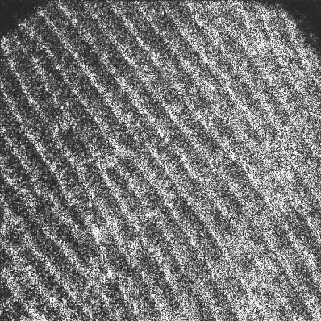
Numerical procedure
The employed numerical procedure to reconstruct our image plane holograms can be described briefly as:
(i) The hologram of unexcited object is obtained before the pulsed excitation by auxiliary laser - B
(ii) The hologram, H is obtained after excitation.
(iii) Two holograms are added, B+H, and then Fourier transformed yielding three separated terms, zeroth, plus first, and minus first order, in the frequency plane.
(iv) An area around plus first diffraction term is isolated and all other points in frequency plane are set to zero.
(v) The resulting image with the isolated part is inversely Fourier transformed and a 2D complex function, A(x,y)exp[iϕ(x,y)] is obtained. Here, A(x,y) represents an amplitude reconstruction, and ϕ(x,y) a phase reconstruction.
FFT
FFT⁻¹

Slide 11
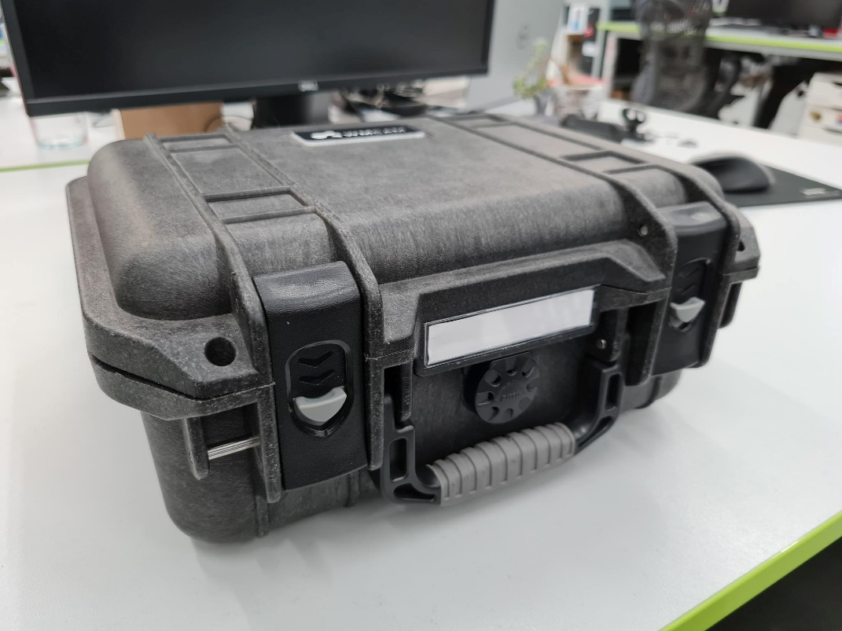
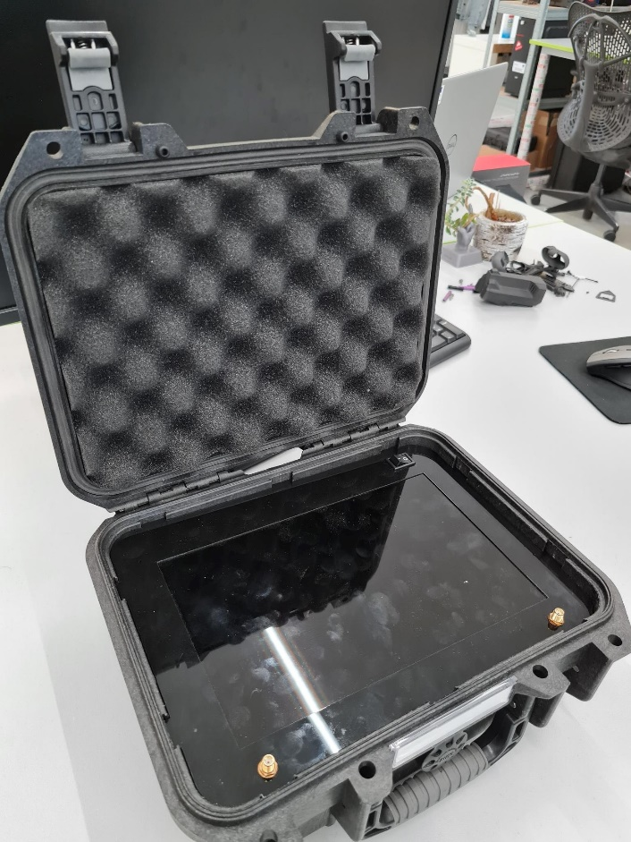
Holograms were recorded at one larger and one smaller magnification, 20 x and 4 x.
Image reconstructions were made after recording, the results are presented here.
Maximum sampling rate was 150 fps at resolution 2252 x 2252.
We have also implemented real-time reconstruction at the frame rate of 30 fps, at 2252 x 2252 resolution using a CUDA 640 GPU standalone unit with 4 GB of RAM

Slide 12
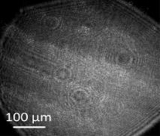
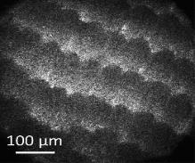
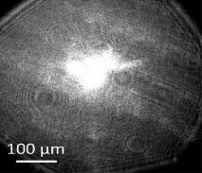
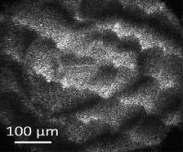
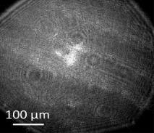
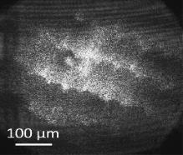
Butterfly wings recorded under larger magnification
Images of the butterfly wing excited by focused laser light of various powers from the front. Both with holograms, reconstructions of the wings are shown. It can be seen how deformation of the wings scales takes larger area for more intense excitation powers, whereas for moderate power, deformation is more localized. Excitation of single scales are visible.
Holograms Reconstructions
No excitation
Excitation 0.28 mW
Excitation 0.0 1mW

Slide 13
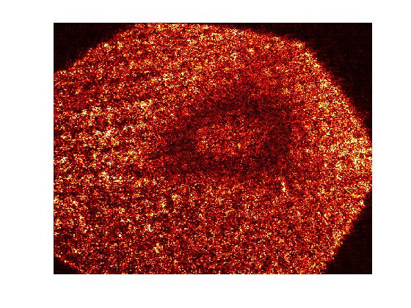
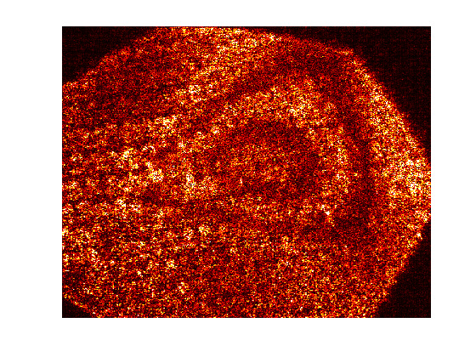
Butterfly wings recorded under smaller magnification, excitation by structured light
Recontruction of beam shaped as a circle (left) and a triangle (right)
We presented the method to detect low level radiation, using scales of the Morpho menelaus butterfly wing. Thermally induced displacements of scales were measured using digital holography. The photophoresis at atmospheric pressure is the underlying mechanism and it would function with other artificial materials and structures, whenever the structures are comparable to the mean free path of molecules of the surrounding gas. The further efforts will be directed to development of such materials and their implementation in multispectral imaging device .

Slide 14
Outlook:
More compact optical setup
Artificial structures for FPA (no more wings)

Slide 15
Live long and prosper

